Slide 1
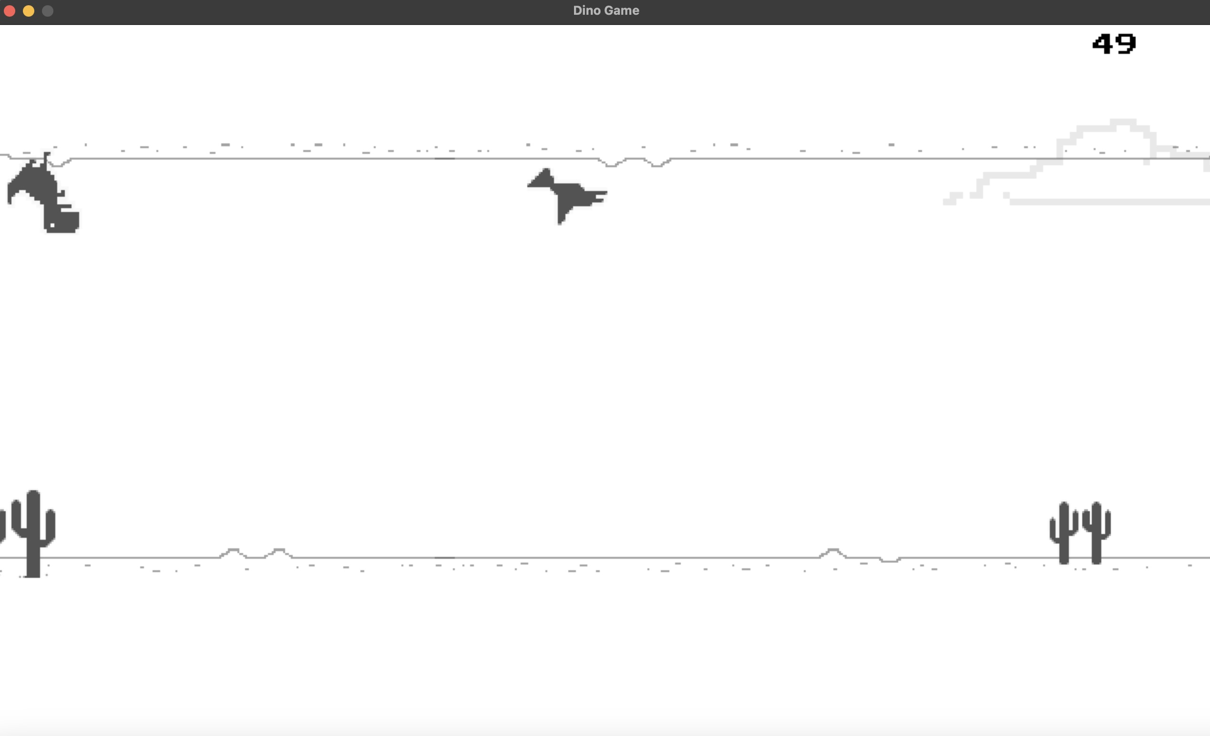

Modded Dino Game
In this version you can play on the ceiling and the floor
By: Connor Gross

